Slide 1


WELCOME TO

Slide 2


Meet the Presenters
Salvador Cortes
Daniel Hardie
Software Developer
Software Developer
📧 salvador.cortes@ptml.com
📧 daniel.hardie@ptml.com

Slide 3

Virtual greetings from PartsTrader
Who is online tonight?
What does PartsTrader do?

Slide 4

Building Sick Serverless Application

Slide 5
Overview
Problem
Solution
Overview of the Cloud
Key AWS services we used
Demo 🤞

Slide 6
Problem
When we're 🤮 we need to:
Notify the team
Notify the boss
Request Sick Leave in iPayroll
Notify the office in the Slack #whereabouts channel...

Slide 7
Problem
This sucks. People are only human 🤔
Can we automate this?

Slide 8
The Solution - Snotbot

Slide 9
The Solution - Snotbot
Snotbot, your sick leave Personal Assistant 🙏

Slide 10

The Solution - Snotbot
Snotbot, your sick leave Personal Assistant 🙏
Team

Slide 11

The Solution - Snotbot
Snotbot, your sick leave Personal Assistant 🙏
Team
Boss

Slide 12

The Solution - Snotbot
Snotbot, your sick leave Personal Assistant 🙏
Team
Boss
Sick leave

Slide 13

The Solution - Snotbot
Snotbot, your sick leave Personal Assistant 🙏
Team
Boss
Sick leave
#whereabouts

Slide 14
What is the Cloud?

Slide 15
What is the Cloud?
A bunch of services on the internet
Services include software, databases and more
Software as a Service (SaaS)
Stops companies maintaining hardware
Different cloud providers (AWS, Azure, GCP)

Slide 16
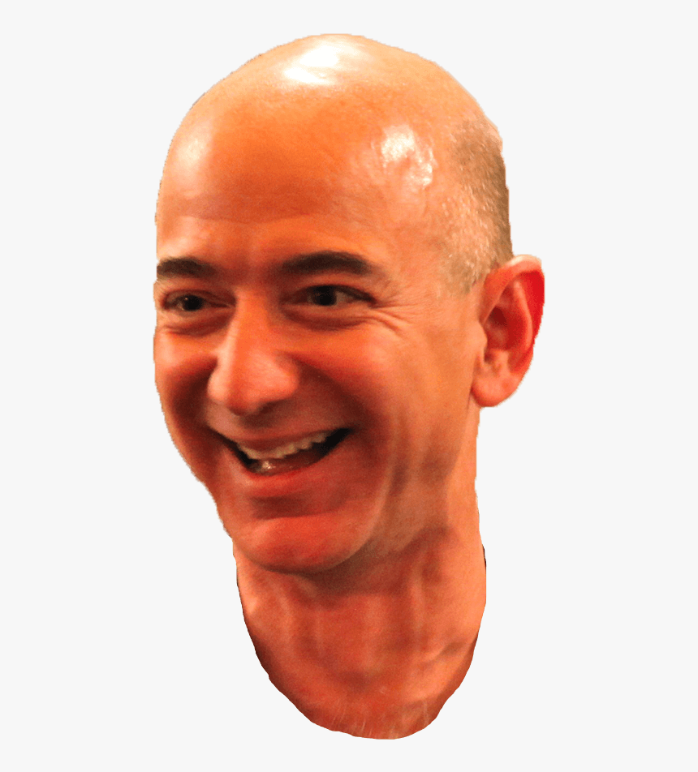
Intro to Amazon Web Services
Founded in 2006
Side effect of the growth of Amazon.com
Currently has ~41.5% market share
Offers 175+ services to customers
https://aws.amazon.com/

Slide 17
Why did PartsTrader pick AWS?
We migrated to AWS in 2017
Previously in Rackspace, very manual
Better cost management
Provision infrastructure on demand

Slide 18
Let’s Dive Into more technical stuff

Slide 19
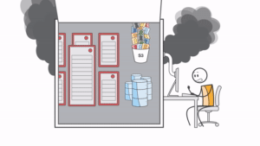
The old-school way
Provision server
Scale
Manage operating systems
Monitor for performance and availability
Introduction to AWS Lambda - Serverless Compute on Amazon Web Services
https://www.youtube.com/watch?v=eOBq__h4OJ4

Slide 20

What do you mean by Serverless?
Misnomer term or, at least, misleading label.

Slide 21

What do you mean by Serverless?
"...with Serverless you don’t have to think about the server at all. So, in effect, it’s “serverless".
“The setup, capacity planning, and server management are invisible to you because they’re handled by the cloud provider”
https://azure.microsoft.com/en-us/overview/serverless-computing/

Slide 22
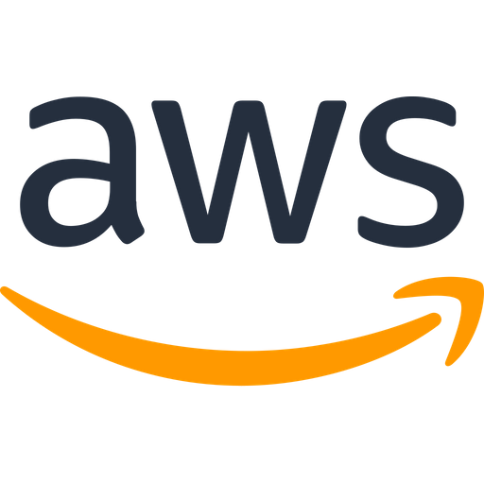
What do you mean by Serverless?
“Serverless applications don’t require you to provision, scale, and manage any servers”
https://aws.amazon.com/serverless/

Slide 23
What do you mean by Serverless?
Serverless allows developers to build and run applications without having to manage servers.

Slide 24
Snotbot

Slide 25
Overview of Snotbot

Slide 26

Overview of Snotbot

Slide 27
Overview of Snotbot

Slide 28

Overview of Snotbot

Slide 29

Overview of Snotbot

Slide 30
Overview of Snotbot

Slide 31

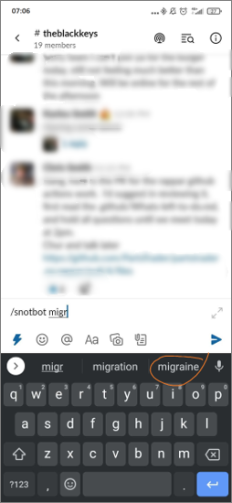


How do we kick it off?
/snotbot migraine

Slide 32

Slack
The widest used messaging system of the company
Development tools
API
Pre-built apps
Supports a few languages
https://slack.com/intl/en-nz/help/articles/115005265703-Create-a-bot-for-your-workspace

Slide 33
Let's step back a little bit again

Slide 34
Requesting Sick Leave
Cloud-based payroll solution
Businesses can do timelogs, HR, and leave management
Provides an API to query and manipulate data
Developer's guide
https://dev.ipayroll.co.nz/

Slide 35

Snotbot Recap Overview
AWS Cloud
Snotbot invoked

Slide 36

Amazon API Gateway
https://aws.amazon.com/api-gateway/

Slide 37


Amazon API Gateway
"Front door" for the AWS cloud
Publish, maintain, monitor, and secure APIs.
https://aws.amazon.com/api-gateway/

Slide 38
Snotbot Recap Overview
AWS Cloud
Snotbot invoked

Slide 39

Snotbot Recap Overview
AWS Cloud
Snotbot invoked
Amazon API Gateway

Slide 40

Amazon Lambda
https://aws.amazon.com/lambda/

Slide 41

AWS Lambda
Serverless compute service
Run code without provisioning or managing servers.
Call it directly from any web or mobile app
You can write Lambda functions in many languages
https://aws.amazon.com/lambda/

Slide 42
Snotbot Recap Overview
AWS Cloud
Snotbot invoked
Amazon API Gateway

Slide 43

Snotbot Recap Overview
AWS Cloud
Snotbot invoked
Send response
Amazon API Gateway
AWS Lambda

Slide 44

Second Lambda in Snotbot
Send leave request to IPayroll
Send email
Notify Slack in the #whereabout channel

Slide 45

Snotbot Recap Overview
AWS Cloud
Snotbot invoked
Send response
Amazon API Gateway
AWS Lambda
Post on #whereabouts
Request sick leave
AWS Lambda

Slide 46

Amazon Simple Queue Service
https://aws.amazon.com/sqs/

Slide 47


Amazon Simple Queue Service
Message queuing service
Send, receive and retry messages
https://aws.amazon.com/sqs/

Slide 48
“Queue” the example
Publisher
Receiver

Slide 49
“Queue” the example
Publisher
Receiver

Slide 50
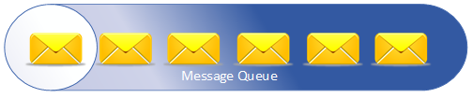
“Queue” the example
Publisher
Receiver

Slide 51

Amazon SQS in Snotbot
Message queue between Lambdas
Each message contains:
Name of employee
Leave reason
Messages will retry if not successful

Slide 52

Snotbot Recap Overview
AWS Cloud
Snotbot invoked
Send response
Amazon API Gateway
AWS Lambda
Amazon Simple Queue Service (Amazon SQS)
Post on #whereabouts
Request sick leave
AWS Lambda

Slide 53

Amazon Simple Email Service
https://aws.amazon.com/ses/

Slide 54


Amazon Simple Email Service
Also known as Amazon SES
Scalable email service
Requires recipient list, subject and body
Super easy to set up
https://aws.amazon.com/ses/

Slide 55
Amazon SES in Snotbot
AWS Lambda

Slide 56

Amazon SES in Snotbot
AWS Lambda
Email payload

Slide 57

Amazon SES in Snotbot
AWS Lambda
Email payload
Amazon Simple Email Service (Amazon SES)

Slide 58
Amazon SES in Snotbot
AWS Lambda
Email payload
Amazon Simple Email Service (Amazon SES)

Slide 59
Snotbot Recap Overview
AWS Cloud
Snotbot invoked
Send response
Amazon API Gateway
AWS Lambda
Amazon Simple Queue Service (Amazon SQS)
Post on #whereabouts
Request sick leave
AWS Lambda

Slide 60
Snotbot Recap Overview
AWS Cloud
Snotbot invoked
Send response
Amazon API Gateway
AWS Lambda
Amazon Simple Queue Service (Amazon SQS)
Post on #whereabouts
Request sick leave
AWS Lambda
Amazon Simple Email Service (Amazon SES)

Slide 61

AWS Secrets Manager
https://aws.amazon.com/secrets-manager/

Slide 62


AWS Secrets Manager
Protects secrets needed to access your applications
Enables you to easily rotate, manage, and retrieve secrets
https://aws.amazon.com/secrets-manager/

Slide 63
Snotbot Recap Overview
AWS Cloud
Snotbot invoked
Send response
Amazon API Gateway
AWS Lambda
Amazon Simple Queue Service (Amazon SQS)
Post on #whereabouts
Request sick leave
AWS Lambda
Amazon Simple Email Service (Amazon SES)

Slide 64

Snotbot Recap Overview
AWS Cloud
Snotbot invoked
Send response
Amazon API Gateway
AWS Lambda
Amazon Simple Queue Service (Amazon SQS)
AWS Secrets Manager
Post on #whereabouts
Request sick leave
AWS Lambda
Amazon Simple Email Service (Amazon SES)

Slide 65

AWS CloudWatch
https://aws.amazon.com/cloudwatch/

Slide 66






AWS CloudWatch
AWS monitoring service
Logs and graphs
Set alarms for abnormal behaviour
https://aws.amazon.com/cloudwatch/

Slide 67

AWS CloudWatch in Snotbot
Created upon Lambda execution
Lambda logs handy for troubleshooting
Use graphs to explore performance:
Error rate, Lambda duration, etc.

Slide 68
Snotbot Recap Overview
AWS Cloud
Snotbot invoked
Send response
Amazon API Gateway
AWS Lambda
Amazon Simple Queue Service (Amazon SQS)
AWS Secrets Manager
Post on #whereabouts
Request sick leave
AWS Lambda
Amazon Simple Email Service (Amazon SES)

Slide 69

Snotbot Recap Overview
AWS Cloud
Snotbot invoked
Send response
Amazon API Gateway
AWS Lambda
Amazon Simple Queue Service (Amazon SQS)
AWS Secrets Manager
Amazon CloudWatch
Post on #whereabouts
Request sick leave
AWS Lambda
Amazon Simple Email Service (Amazon SES)

Slide 70

AWS Identity and Access Management
https://aws.amazon.com/iam/

Slide 71


AWS Identity and Access Management
Also known as AWS IAM
Manages permissions
Rule of least privilege
https://aws.amazon.com/iam/

Slide 72
Snotbot Recap Overview
AWS Cloud
Snotbot invoked
Send response
Amazon API Gateway
AWS Lambda
Amazon Simple Queue Service (Amazon SQS)
AWS Secrets Manager
Amazon CloudWatch
Post on #whereabouts
Request sick leave
AWS Lambda
Amazon Simple Email Service (Amazon SES)

Slide 73
Snotbot Recap Overview
AWS Cloud
Snotbot invoked
Send response
Amazon API Gateway
AWS Lambda
Amazon Simple Queue Service (Amazon SQS)
AWS Secrets Manager
Amazon CloudWatch
Post on #whereabouts
Request sick leave
AWS Lambda
Amazon Simple Email Service (Amazon SES)

Slide 74
Snotbot Recap Overview
AWS Cloud
Snotbot invoked
Send response
Amazon API Gateway
AWS Lambda
Amazon Simple Queue Service (Amazon SQS)
AWS Secrets Manager
Amazon CloudWatch
Post on #whereabouts
Request sick leave
AWS Lambda
Amazon Simple Email Service (Amazon SES)

Slide 75

Snotbot Recap Overview
AWS Cloud
Snotbot invoked
Send response
AWS Identity and Access Management (IAM)
Amazon API Gateway
AWS Lambda
Amazon Simple Queue Service (Amazon SQS)
AWS Secrets Manager
Amazon CloudWatch
Post on #whereabouts
Request sick leave
AWS Lambda
Amazon Simple Email Service (Amazon SES)

Slide 76
Demo

Slide 77
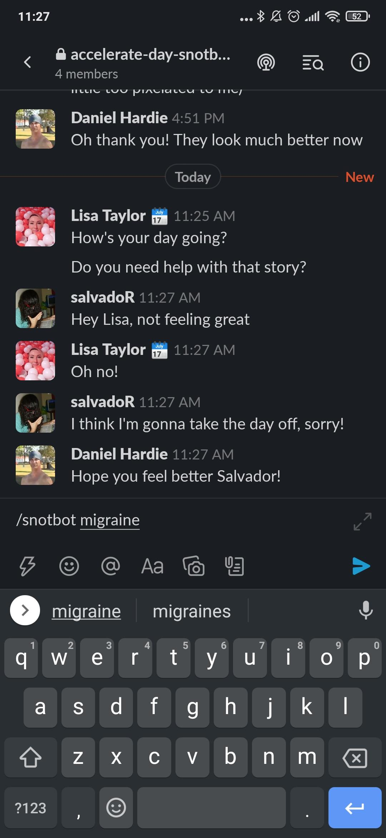

Slide 78
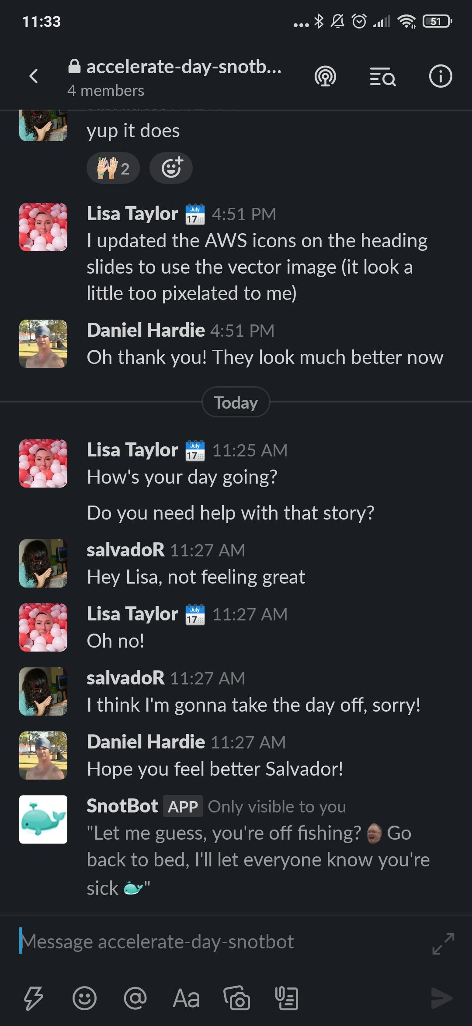

Slide 79
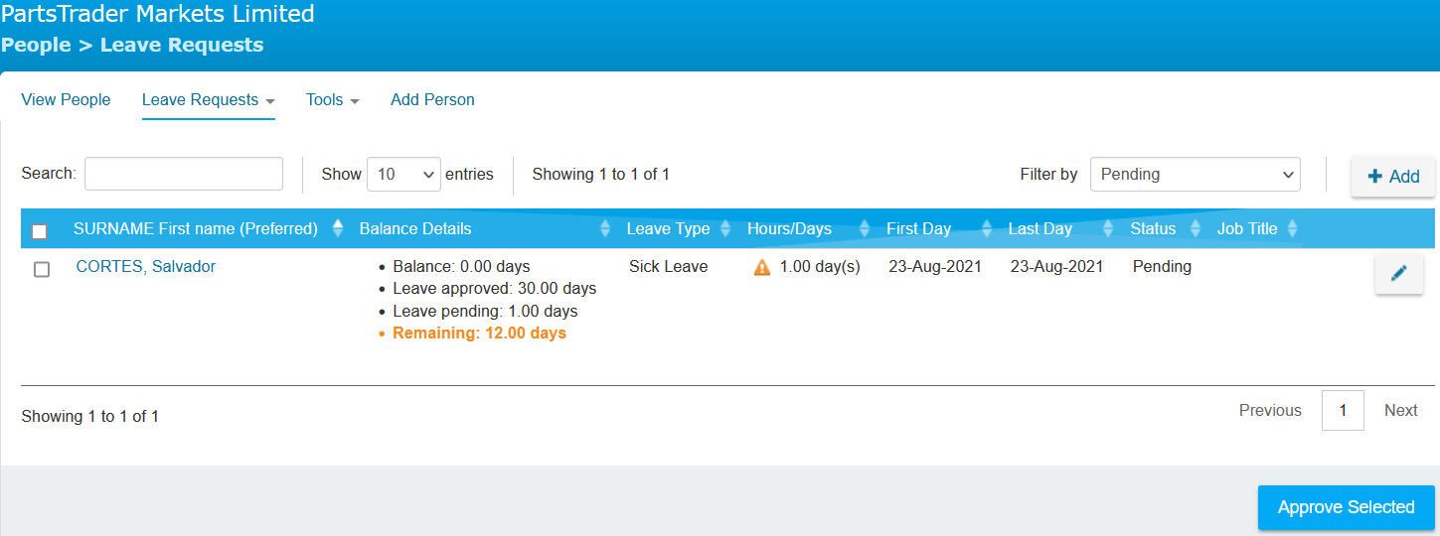

Slide 80
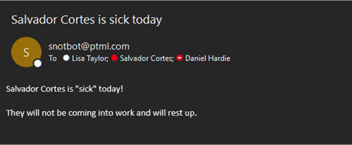

Slide 81
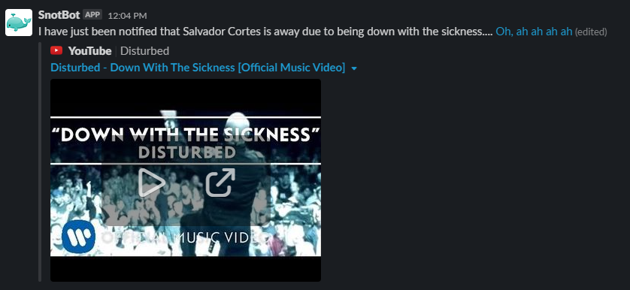

Slide 82



Cost assumptions
32 sick leave days a month on average
Employee calls Snotbot only once per day
AWS Pricing Calculator

Slide 83
How much does it cost?
AWS Service | Cost per month (USD)
AWS Lambda | 0.00
Amazon API Gateway | 0.00
Amazon SQS | 0.00
Amazon SES | 0.01
AWS Secrets Manager | 1.60
Amazon CloudWatch | 0.90
AWS IAM | 0.00
Monthly Total | 2.51
Yearly Total | 30.12

Slide 84
Future work
Decouple into more lambdas and queues
Gather employee data from Azure Active Directory
Increase scope to include annual leave
Introduce Infrastructure as Code (IaC)
Add more friendly user interface

Slide 85
Getting started with AWS
Cloud Practitioner certification [1]
AWS Cloud Practitioner Essentials [2]
A Cloud Guru [3]
Pluralsight – David Tucker [4]
Udemy – Stephane Maarek [5]

Slide 86
Links to getting started with AWS
https://d1.awsstatic.com/training-and-certification/ramp-up_guides/Ramp-Up_Guide_CloudPractitioner
https://www.aws.training/Details/eLearning?id=60697
https://acloudguru.com/
https://www.pluralsight.com/courses/fundamental-cloud-concepts-aws?exp=1
https://www.udemy.com/course/aws-certified-cloud-practitioner-new/

Slide 87

Where can I find this stuff?
bit.ly/sot-snotbot

Slide 88


Q&A Time
Any questions?
bit.ly/sot-snotbot

Slide 89
Roles at PartsTrader
3x Software Developers
2x Software Testers
2x System Engineer
1x Cloud
1x Internal
1x Data Engineer
bit.ly/sot-snotbot

Slide 90
Breakout Rooms

Slide 91


Q&A Time
Answers these three questions to go into the draw for a prize:
What does Amazon SQS do?
What is Amazon SES used for?
What does PartsTrader do?
Email your answers to snotbot@ptml.com by 5pm
today! Winners will be announced next week
bit.ly/sot-snotbot

Slide 92
Thanks for listening!
Salvador Cortes
Daniel Hardie
Software Developer
Software Developer
📧 salvador.cortes@ptml.com
📧 daniel.hardie@ptml.com
bit.ly/sot-snotbot

